Slide 1

Advanced Programming (Level 5) Lecture 1
Welcome to the Module

Slide 2
Advanced Programming
Lecture 1
Welcome to the module

Slide 3

Before continuing –
lets just take a moment

Slide 4
3 Main Module Aims
1.
Further develop and explore the principles of object-oriented design and development.
2.
To advance programming and problem-solving skills.
3.
To expand the ability to design and write high quality software demonstrating an appreciation of the issues of software re-use, quality and the use of an architecture- based approach to software construction.

Slide 5
7 Module Based Learning Outcomes
Demonstrate an understanding of the advanced principles and concepts of Object Oriented Programming.
Apply object-oriented techniques and create object-oriented models of reasonable complexity
Define problems and write large programs.
Analyse a problem and determine what problem elements to represent as functions or objects.
Effectively use inheritance to promote reuse.
Deploy best practice, techniques and tools for the development and documentation of advanced computing systems.
Appreciate the need for continuing professional development in recognition of the need for lifelong learning, professionalism and employability.

Slide 6
Week 1 – Assignment 1
This week explores and provides opportunities to practice using the language to solve, implement and document a range of problems using C++.

Slide 7
Week 2 – Assignment 2
Week two introduces, discusses and implements the ideas and principles of object oriented design patterns in a language of your choice
The outcome of this week will be your development of an advanced programming project to highlight your ability to:
Use good problem solving skills.
Adopt good design, programming and testing standards.
Implementing a high quality, internally documented solution to an assigned problem.

Slide 8
Week 1 – Expectations
You should (by the end of this first week) be expected to have completed numerous C++ programs that you will be able to refer to and/or reuse as necessary.

Slide 9

Week 1 – Welcome Doc
A quick review of the schedule for the week.

Slide 10
Topics
Paradigms
Layers of Abstraction
Data Types
Standard Library
C++ Example
4. REPL.IT

Slide 11

Advanced Programming: Paradigms

Slide 12
What is Programming? Discuss on Mentimeter
Notes:
Process of instructing a computer to perform a specific set of tasks or operations
Writing a series of instructions in the form of code or a program that a computer can understand and execute

Slide 13
What does programming involve?
Discuss on Mentimeter
Notes:
Problem solving
Writing code
Syntax
Compilation or interpretation
Testing
Debugging
Optimisation
Documentation
Version Control
Deployment

Slide 14
C++ Advanced Programming
All programming languages are generally made up of the following 5 aspects:
Program Structure (overall logic used to design solutions)
Variable Declarations
Looping Structures
Control Structures (mechanisms used to control the execution flow)
Syntax (the language’s defined vocabulary and semantics)

Slide 15
C++ Advanced Programming
Programming languages are artificial languages used to control the behaviour of a machine. To learn any programming languages the programmer must understand its syntactic and semantic rules.
Syntactic (syntax) refers to the rules that describe the valid use and combination of symbols and tokens; can be language specific.
Semantic refers to the meaning of valid syntax; can be conceptual abstraction
Syntactically wrong
Syntactically correct but semantically wrong
sparrow little has a test flying big
little sparrow has a big flying test
int x;
x = 2 ^ 3;
rough sparrow was the huge laughing pit
Notes:
https://www.usna.edu/Users/cs/wcbrown/courses/F19SI413/lec/l07/lec.html#:~:text=In%20defining%20or%20specifying%20a,programs%20mean%2C%20what%20they%20do.
^ id bitwise XOR in C/C++

Slide 16
〝
Paradigm – In simple terms, a paradigm is a way of looking and thinking about something; this could include using a pattern, a computer model or a set of processes, etc.
Object Orientated v Imperative Programming Styles
Notes:
A paradigm refers to a set of accepted beliefs, principles, practices, and perspectives that guide thinking, problem-solving, and decision-making. It provides a framework or model for understanding and approaching a particular subject or field of study.

Slide 17
C++ Advanced Programming
Programming paradigms are used to help solve problems by allowing developers to adopt different styles or “ways” of designing and coding the program; different languages often focus on different paradigms.
The following (five) are not an exhaustive or absolute list:
Imperative & Structured Programming
Declarative Programming
Event-Driven Programming
Object-Oriented Programming
Functional Programming

Slide 18
What is Imperative programming? Discuss on Mentimeter
Notes:
The steps and sequences are explicitly given
The programmer explicitly defines the order of execution of the instruction.
Main characteristics are assignment statements and global variables

Slide 19
Imperative & Structured
Flow control (based on the instruction points execution of code) in an imperative language is generally explicit (i.e. stated clearly, in detail, with no room for confusion) and global, the instructions and commands indicate how each step of the algorithm takes place and how to achieve the required results.
result = [ ] i = 0
start:
numPeople = length(people)
if i >= numPeople goto finished
p = people[ I ]
nameLength = length(p.name)
if nameLength <= 5 goto nextOne
upperName = toUpper(p.name) addToList(result, upperName)
nextOne: i = i + 1
result = [];
for i = 0; i < length(people); i++ { p = people[i];
if length(p.name)) > 5 { addToList(result, toUpper(p.name));
}
}
return sort(result);
goto start finished:
return sort(result)
Although there is always levels on overlap, one of the differences between Imperative and Structured is that structured allows for nested loops, conditional blocks, functions and subroutines together with the use
of local variables
Notes:
Structured programming is a more organized and disciplined approach within the broader imperative paradigm. It enforces modularity, code reusability, and clearer control flow through the use of functions or procedures and well-structured control structures. Traditional imperative programming can be less structured and more concerned with explicitly detailing the sequence of steps to achieve a task.

Slide 20
What is Declarative programming? Discuss on Mentimeter

Slide 21
Declarative
Flow control in a declarative language is implicit (i.e. suggested, not directly expressed, inferred, understood). In essence, the programmer states what the result should look like, they are not interested (at this point) in how to process or obtain it. NB. Functional programming falls within a declarative paradigm by focusing on the ‘what’ while the ‘how’ is abstracted away.
SELECT
UPPER(name)
FROM
people
WHERE
LENGTH(name) > 5
ORDER BY
name
There is typically no loops, no assignments, etc. It is down to the language’s engine to interpret the code and is simply expected to get the desired information; it can use whatever method or approach it wants (or has been designed,
preconfigured or set to use).
Notes:
Declarative Paradigm: we only tell the computer what the problem is and let the system decide what steps to take and the sequence of those steps.
Imperative says how to do it, and declarative says what to do.
Imperative vs. Declarative paradigms:
In the Imperative paradigm, the programmer instructs the machine on how to change its state. In the declarative paradigm, the programmer merely declares properties of the desired result, but not how to compute it.
Analogies:
1. Suppose you are in the restaurant, and while ordering your food, you don’t just choose the dish, but you also give instructions to the chef on how to prepare the dish.
2. Consider a programmer as a King and computer as an army of that King. In the imperative style of programming king not only gives orders to do some actions to the military but also instruct how to execute those actions.

Slide 22
What is Event Driven programming? Discuss on Mentimeter

Slide 23
Event Driven Programming Concepts
Events:
Occurrences triggering specific actions.
Can be user-initiated (e.g., button clicks), system-generated (e.g., timer expiration), or data-related (e.g., network messages).
Event Handlers:
Functions or methods associated with events.
Execute in response to events.
Define what should happen in response to a specific event.
Asynchronous Execution:
Event-driven programs are asynchronous.
Respond to events in a non-blocking manner.
Allows the program to handle multiple events without waiting for one to finish.
Notes:
Event driven programming is a programming paradigm that focuses on writing software that responds to events or signals rather than executing instructions sequentially.
Events: Events are occurrences or happenings that trigger specific actions in a program. These events can be user-initiated (e.g., button clicks), system-generated (e.g., a timer expiration), or data-related (e.g., receiving a message over a network).
Event Handlers: Event handlers are functions or methods that are associated with specific events. When an event occurs, the corresponding event handler is executed to respond to the event. Event handlers define what should happen in response to a particular event.
Asynchronous Execution: Event-driven programs are typically asynchronous, meaning that they can respond to events in a non-blocking manner. This allows the program to continue functioning and responding to other events even if some events take time to process.

Slide 24
Event Driven Programming Concepts - continued
Event Queue:
Events are stored in a queue as they occur.
Processed in the order they were received.
Ensures consistent and orderly event handling.
Event-Driven GUIs:
Commonly used in graphical user interfaces (GUIs).
Handle user interactions like button clicks, mouse movements, and keyboard input.
Events generated by user actions are processed by event handlers.
Notes:
Event Queue: Events are often placed in an event queue as they occur. The program processes events from this queue in the order they were received. This ensures that events are handled in a consistent and orderly fashion.
Event-Driven GUIs: Event-driven programming is commonly used in graphical user interfaces (GUIs) to handle user interactions like button clicks, mouse movements, and keyboard input. When a user interacts with a GUI, events are generated and handled by the associated event handlers.

Slide 25
Event Driven Programming Concepts - continued
Decoupled Components:
Promotes loose coupling between system components.
Components interact through events without needing knowledge of each other's internals.
Enhances modularity and maintainability.
Flexibility and Responsiveness:
Event-driven systems are highly responsive and adaptable.
Can accommodate changes in event order and frequency without major code modifications.
Notes:
Decoupled Components: Event-driven programming promotes loose coupling between different components of a system. Components can interact through events without needing to be aware of each other's internal details, which enhances modularity and maintainability.
Flexibility and Responsiveness: Event-driven systems are known for their responsiveness and adaptability. They can easily accommodate changes in the order and frequency of events without significant modifications to the code.

Slide 26
What is Object Oriented Programming? Discuss on Mentimeter

Slide 27
Object Oriented (OO)
Object-Oriented Programming (OOP) is a programming paradigm that organizes and structures code around the concept of object
OOP is designed to model real-world entities and their interactions in a more natural and intuitive way

Slide 28
Object Oriented (OO)
Modularity:
Breaks down complex systems into manageable components
Eases code understanding, maintenance, and extension
Reusability:
Promotes code reuse through mechanisms like inheritance.
Reduces redundant code and encourages the "write once, use many times" principle
Abstraction:
Models real-world entities and behaviors more accurately
Simplifies complex systems by hiding internal details, enhancing code readability
Notes:
Modularity: OOP promotes modularity by allowing you to break down complex systems into smaller, manageable components (objects). This modularity makes code easier to understand, maintain, and extend. Each object encapsulates its own data and behavior, reducing complexity.
Reusability: OOP facilitates code reuse through mechanisms like inheritance. You can create new classes by inheriting attributes and methods from existing classes, reducing redundant code and promoting the "write once, use many times" principle.
Abstraction: OOP allows you to model real-world entities and their behaviors more accurately through classes and objects. This abstraction simplifies complex systems by hiding internal details and exposing only what's necessary. It enhances code readability and reduces complexity.

Slide 29
Object Oriented (OO)
Encapsulation:
Protects data integrity by restricting access
Minimizes the risk of unintended data manipulation and promotes data consistency
Polymorphism:
Enables code to work with objects of various classes in a consistent way
Simplifies code, enhances flexibility, and supports handling different object types with a common interface
Notes:
Encapsulation: Encapsulation helps protect the integrity of data by restricting access to it. You can specify which data is private and should not be modified directly. This promotes data consistency and reduces the risk of unintended data manipulation.
Polymorphism: Polymorphism enables you to write code that works with objects of various classes in a consistent way. It simplifies code, promotes flexibility, and allows you to handle different types of objects using a common interface.

Slide 30
Object Oriented (OO)
Maintainability:
Facilitates easier maintenance and debugging
Isolates changes, reducing the impact on other parts of the system
Collaborative Development:
Supports collaborative software development by enabling multiple developers to work on different components
Real-World Modeling:
Useful for modeling real-world systems and entities
Makes it easier for domain experts to understand and work with the software
Notes:
Maintainability: OOP makes code easier to maintain. Changes to one part of the system, if done correctly, should have minimal impact on other parts. This separation of concerns and clear division of responsibilities within objects makes debugging and maintenance less challenging.
Collaborative Development: OOP is well-suited for collaborative software development. Multiple developers can work on different classes or objects independently, and their work can be integrated into the overall system more effectively.
Real-World Modeling: OOP is particularly useful when modeling real-world systems and entities. It allows you to create software that closely mirrors the structures and relationships found in the physical world, making it easier for domain experts to understand and work with the software.

Slide 31
Object Oriented (OO)
Software Design Patterns:
Many common design patterns are based on OOP principles.
Provides proven solutions to recurring design problems, improving software quality.
Code Organization:
Structured approach to organizing code.
Enhances code manageability and comprehensibility.
Software Quality:
Leads to higher software quality through improved organization, reduced redundancy, and better modeling of real-world entities
Notes:
Software Design Patterns: Many common software design patterns, such as the Singleton, Factory, Observer, and MVC (Model-View-Controller), are based on OOP principles. These patterns provide proven solutions to recurring design problems, improving software quality and maintainability.
Code Organization: OOP provides a structured way to organize code, making it more manageable and comprehensible. This organization helps developers find and work with the relevant parts of the codebase efficiently.
Software Quality: OOP can lead to higher software quality through improved organization, reduced redundancy, and better modeling of real-world entities. It often results in more maintainable, extensible, and reliable software.

Slide 32
What is Functional Programming? Discuss on Mentimeter

Slide 33
Functional Programming
A programming paradigm that treats computation as the evaluation of mathematical functions.
Avoids changing state or mutable data.
Relies on functions to produce new data and return results.
Notes:
Functional Programming (FP) is a programming paradigm that treats computation as the evaluation of mathematical functions and avoids changing state or mutable data.
Instead of altering data, FP relies on the evaluation of functions that produce new data and return results.

Slide 34
What are pure functions? Discuss on Mentimeter

Slide 35
Functional: Pure Functions
A pure function is a function which:
Given the same inputs always returns the same response.
Has no side effect
let total = 0;
function add1(x) {
total += x;
return total;
}
function add2(x, y) {
return x + y;
}
Advantages of pure functions
Predictability
Testability
Reusability
Parallelism and concurrency
Caching and memorization

Slide 36
Functional Programming: Immutability
In functional programming, data is immutable.
Immutable data means that once it's created, it cannot be changed.
To modify data in FP, you create a new copy of the data with the desired changes.
This approach simplifies concurrency handling and eliminates race conditions.
// Mutable (Changing original array)
let mutableArray = [1, 2, 3];
mutableArray[0] = 10;
// Immutable (Creating a new array)
let immutableArray = [1, 2, 3];
// Create a new array
let newArray = [...immutableArray];
newArray[0] = 10;

Slide 37
Functional Programming: Higher Order Functions
Functions in FP are considered first-class citizens.
They can be assigned to variables
They can be passed as arguments to other functions
They can be returned from functions
Higher-Order Functions:
Higher-order functions are functions that take one or more functions as arguments.
They can also return functions as their results.
function applyOp(value, op)
{
return op(value);
}
function double(x)
{
return x * 2;
}
function square(x)
{
return x * x;
}
console.log(applyOp(5, double));
console.log(applyOp(3, square));

Slide 38
Functional Programming: Function Composition
// Two simple functions
function addTwo(x) {
return x + 2;
}
function multiplyByThree(x) {
return x * 3;
}
// Function composition
function compose(f, g) {
return function (x) {
return f(g(x));
};
}
// Compose the two functions
const addTwoThenMultiplyByThree = compose(multiplyByThree, addTwo);
// Usage
const result =
addTwoThenMultiplyByThree(4);
// Result: (4 + 2) * 3 = 18
console.log(result);
Functional programming encourages the composition of functions to create more complex operations.
Functions are combined to build a pipeline of data transformations.
This approach makes the code concise and readable.
Each function in the pipeline processes the data step by step, leading to a clear and understandable flow of operations.

Slide 39
Functional Programming: Recursive Functions
Functional programming (FP) prefers recursion over loops for repetitive tasks.
Recursion is a technique where a function calls itself to solve problems in a repetitive manner.
In recursion, you don't need to change variables in a loop; instead, you create new instances of data, preserving immutability.
This aligns with FP's principle of avoiding mutable state and encourages creating new data with each recursive call, making code more predictable and robust.
function factorial(n) {
// Base case: Stop when n is 0 or 1
if (n === 0 || n === 1) {
return 1;
} else {
// Recursive case: Calculate factorial by calling the function with a smaller number
return n * factorial(n - 1);
}
}
const result = factorial(5); // Calculate the factorial of 5
console.log(`Factorial of 5 is: ${result}`);

Slide 40
Programming in C++
Most popular OOP languages mix imperative, structured and functional programming paradigms into their syntax and semantic standard
By completing the various workshops and programming challenges this week you will be using a mix of Object Orientated, Imperative & Structured and Functional programming paradigms.
Investing time in building your experience with different languages will help you gain more opportunities to deepen your possible understanding while also help create and separate the use of language specific syntax to more concepts based on sematic abstractions; essentially making it easier for you to adapt to different syntax requirements.

Slide 41
What should the characteristics be
What do you think are the characteristics/skills of an advanced programmer?
Discuss on Mentimeter

Slide 42
Advanced Programming
Layers of Abstraction

Slide 43
Advanced Programming; Layers of Abstraction
Very few languages implement a 100% OO paradigm. When they do, they are pure; it is generally, incredibly rare to have a “pure OO” language.
Lots of languages will support more than one paradigm; If a language
is purposely designed to support many paradigms, it can be called a ”multi-
paradigm” language – there is no term to define a language that accidentally supports multiple paradigms.
All languages (in the end) have to be converted into binary code (by either a complier or interpreter), so essentially (and regardless of the programming paradigm) they will all end up being executed as imperative code; therefore in essence, we are simply talking about layers of abstraction.

Slide 44
HIGH & LOW LEVEL LANGUAGES
Programming languages are classified on a range of high-level to low-level languages.
The terms “high” or “low” describes the languages level of abstraction.
The more abstract (or higher-level) a language is the further it is from the actual instructions being executed.
High level languages are generally (closer to human type languages):
Easier to learn
Easier to read
Easier to modify
Easier to understand
Low level languages are generally:
Faster to execute
Platform specific

Slide 45
HIGH-LEVEL: JAVASCRIPT
Accept a number in variable AX, if the number is in the range 100 – 150 subtract 100, otherwise leave is unchanged.
function SUB50(AX) { //procedure starts here
if ( (AX >= 100) && (AX <=150) ) { //is AX >= to 100 AND is AX <= to 150
AX = AX – 50; //subtract 50 and store the result back in AX
}
return AX; //return to the main program
} //procedure ends here

Slide 46
LOW-LEVEL: ASSEMBLER
Accept a number in register AX, if the number is in the range 100 – 150 subtract 100, otherwise leave unchanged.
SUB50:
//procedure starts here
//compare the AX register with the value 100
//if less than 100 then jump to “done”
//compare the AX register with the value 150
//if greater than 150 then jump to “done”
//subtract 50 from the value stored in the AX register
//define the position for “done”
//return to main program, procedure ends here
CMP AX, 100; JL DONE; CMP AX, 150; JG DONE; SUB AX, 50;
DONE:
RET;

Slide 47
LOWEST-LEVEL: MACHINE CODE
Accept a number in register AX, if the number is in the range 100 – 150 subtract 100, otherwise leave is unchanged.
011001011011001100001011110101001010010110101100110010010010100110101110
101101011011011101001010010010010010110110100101001110110101011101101101
110011010110101001101010001001001001001001001011011101011101010101000001
000100100110110111101010101101101101101100101010100100110111011101011101
101101011011112010010100100100100101101101000101001110110101011101101101
110010011011011110101010110110110110110101001010100100110110111101011111
010110110110110110101001010011010110110111010010102100100100101101101100
Are there any BUGs in the code block?

Slide 48
MID-LEVEL: C++
Displays a message to the user, waits for their name (as an input), stores it in a variable and outputs a personal ‘Hello’ to the user.
int main() {
std::string name; //declare a variable
std::cout << "Enter your name: "; //output a message
std::cin >> name; //get input
std::cout << "Hello " << name << "\n"; ////output a message
}

Slide 49
ADVANCED PROGRAMMING
DATA TYPES

Slide 50
TYPE
A Type System of a programming language defines how it:
Classifies values and expressions
Manipulates and interacts with values and expressions
Supports different data structures
Its ALL about DATA
Internally, in a typical computer all data is stored using binary (ones and zeros). However, this has little bearing on real world information (e.g. names, account numbers, measurements etc), so part of the programming languages job is to organise these “low-level” binary values into the higher-level concepts called data types.

Slide 51
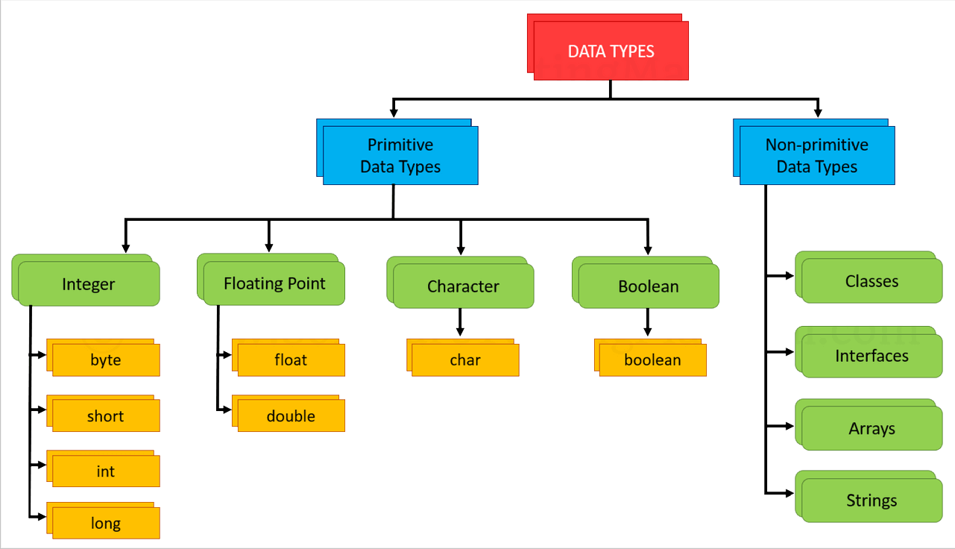
COMMON TYPES

Slide 52
Static vs Dynamic Type Checking
What is the difference between Static and Dynamic Type Checking?
Discuss on Mentimeter

Slide 53
Static Typing Checking
In typed programming languages, variable types are explicitly declared at compile-time
The type of a variable is determined before the program is executed
Type Safety
Type checking is performed at compile-time to ensure that variable data types are compatible
This helps identify type-related errors before the program runs
Languages like C, C++, Java, and C# are statically typed
You declare the data type of a variable when you define it, such as int x or string name
Notes:
Static Type Checking: In typed programming languages, variable types are explicitly declared at compile-time. The type of a variable is determined before the program is executed.
Type Safety: Type checking is performed at compile-time, ensuring that the data types of variables are compatible. This helps catch type-related errors before the program runs.
Examples: Languages like C, C++, Java, and C# are statically typed. You declare the data type of a variable when you define it, such as int x or string name.

Slide 54
Static Typing Checking
Advantages:
Enhanced code reliability and safety due to early error detection.
Improved code readability and maintainability, as data types are explicitly stated.
Disadvantages:
Requires more verbose type declarations, potentially leading to longer code.
May slow down development in cases where flexibility is needed.

Slide 55
Dynamic Type Checking
Variable types are determined at runtime
No need to declare types explicitly, and variables can change types during program execution
Type Flexibility
Variables can dynamically change their type, allowing for more flexible and concise code
This flexibility supports rapid development and adaptability
Examples:
Languages like Python, JavaScript, Ruby, and PHP are dynamically typed.
You can assign a value to a variable without explicitly stating its type, such as x = 10 or name = "John".
Notes:
Dynamic Type Checking: In untyped programming languages, variable types are determined at runtime. There is no requirement to declare types explicitly, and variables can change types during program execution.
Type Flexibility: Variables can change their type dynamically, which can lead to more flexible and concise code. This flexibility allows for rapid development.
Examples: Languages like Python, JavaScript, Ruby, and PHP are dynamically typed. You can assign a value to a variable without explicitly stating its type, such as x = 10 or name = "John".

Slide 56
Dynamic Type Checking
Advantages:
Code is often more concise and expressive due to the absence of type declarations.
Promotes flexibility and rapid development, making it suitable for scripting and prototyping.
Disadvantages:
May lead to runtime errors related to type mismatches.
Debugging can be more challenging because type-related errors only become apparent during execution.

Slide 57
Weak vs Strong Typing
What is the difference between weak and strong type checking?
Discuss on Mentimeter

Slide 58
Weak and Strong Typing
Weak Typing:
Allows for flexible data type handling.
Permits implicit type conversions and type coercion.
Operations may automatically convert data between types.
Strong Typing:
Enforces strict type rules and consistency.
Requires explicit type conversions or casting when types differ.
Does not perform implicit type coercion, which promotes type safety.
Prioritizes type consistency and correctness over flexibility.
let var1 = "42";
let var2 = 10;
let result = var1 + var2;
console.log(result);
Guess the output
Notes:
The result will be "4210"

Slide 59
ADVANCED PROGRAMMING
STANDARD LIBRARY

Slide 60

CORE LIBRARY
Most programming languages have an associated core library (sometimes known as the “Standard library”). The core library is generally available by all implementations (versions, releases, etc.) of the language.
Core libraries typically include definitions for commonly used algorithms, data structures, and mechanisms for input and output.
The line between a language and its core library differs from language to language and some programmers often treat the library as “part” of the language. C++ is designed so that certain syntactic constructs cannot be used without referring to the core library.

Slide 61

C + + E X A M P L E

Slide 62

C++ EXAMPLE
Lets examine a simple code block:
int main() { int A = 10;
std::cout << A << std::endl; A++;
std::cout << A << std::endl;
return 0;
}
Line 1
Declares a ‘function’ with return type as type ‘int’ (i.e. will return a whole number).
1
We can see that the ‘function’ called ‘main’ does not declare any parameters (variable names listed in the round brackets) therefore the function will not expect any parameters to be passed when it is called (executed).
The curly braces (shown on line 1 and 7) are used to indicate the start and end (scope) of the function; once the function has completed any variables declared within will be completely destroyed.
7

Slide 63
C++ EXAMPLE
Lets examine a simple code block:
int main() { int A = 10;
std::cout << A << std::endl; A++;
std::cout << A << std::endl;
return 0;
}
Line 2
Declares a ‘variable’ as type ‘int’ (e.g. will hold a whole number).
2
Variables names must start with a letter or an underscore and be made up of letters (Aa-Zz), numbers (0-9) and underscores. Note that C++ is case sensitive.
Try to make sure your variable’s name helps the programmer document its purpose. In this example we are also initialise its value to 10;

Slide 64

C++ EXAMPLE
Lets examine a simple code block:
int main() { int A = 10;
std::cout << A << std::endl; A++;
std::cout << A << std::endl;
return 0;
}
Line 3 and Line 5
Okay, this is a bit more complicated – so lets break it down further.
std::cout
‘std’ tells the compiler to look in the languages ‘standard’ (a.k.a. core) library; review previous notes
3
std::cout
‘cout’ tells the compiler to use the ‘console’ ‘output’ device (this simply means the monitor).
5
std::cout
‘::’ is used to separate the library from the operation
Notes:
std refers to the C++ standards library.
std is the namespace that provides access to the C++ standard library
Namespace prevent naming conflicts and ensures that the C++ compiler knows where to find these standard objects

Slide 65
C++ EXAMPLE
Lets examine a simple code block:
int main() { int A = 10;
std::cout << A << std::endl; A++;
std::cout << A << std::endl;
return 0;
}
Line 3 and Line 5 (continued)
Okay, this is a bit more complicated – so lets break it down further.
3
Here the double angled brackets (<<) means “direct the ‘output’ from side (e.g. the value of the variable A) to be the ‘input’ of the other (e.g. the standard output device(std::cout)).
5
Okay lets see if we can simplify that further to be ‘send the value of what's on the right of the << to the receiver on the left; basically print the value of A.
I see, but what’s is the second ‘<<‘ doing?

Slide 66
C++ EXAMPLE
Lets examine a simple code block:
int main() {
int A = 10;
std::cout << A << std::endl;
A++;
std::cout << A << std::endl;
return 0;
}
Line 4
As explained earlier – this increments the value stored in the variable ‘A’ by 1.
Another way this could be done is: A = A + 1;
4

Slide 67
C++ EXAMPLE
Lets examine a simple code block:
int main() { int A = 10;
std::cout << A << std::endl; A++;
std::cout << A << std::endl;
return 0;
}
Line 5 (and Line 3)
Can you remember?
5

Slide 68
C++ EXAMPLE
Lets examine a simple code block:
int main() {
int A = 10;
std::cout << A << std::endl;
A++;
std::cout << A << std::endl;
return 0;
}
Line 6 (finally!)
return
The keyword ‘return’ tells the computer that once the execution pointer (which works almost exactly like a C pointer) gets to this line it should ‘return’ control (with any specified value) to the line that called the function in the first place. This process allows us to ‘daisy chain’ simple functions together to create robust and more complex solutions.
The value returned can then be caught, stored and used as would be appropriate and as designed.
6
Notes:
return 0;: This line typically appears at the end of the main function. It's used to indicate that the program has run to completion without any errors. In C++, a return value of 0 conventionally indicates a successful execution, while a non-zero value can be used to signal an error or abnormal termination.

Slide 69
http://REPLIT.COM
Online, Multi-Language Development Platform

Slide 70


Slide 71
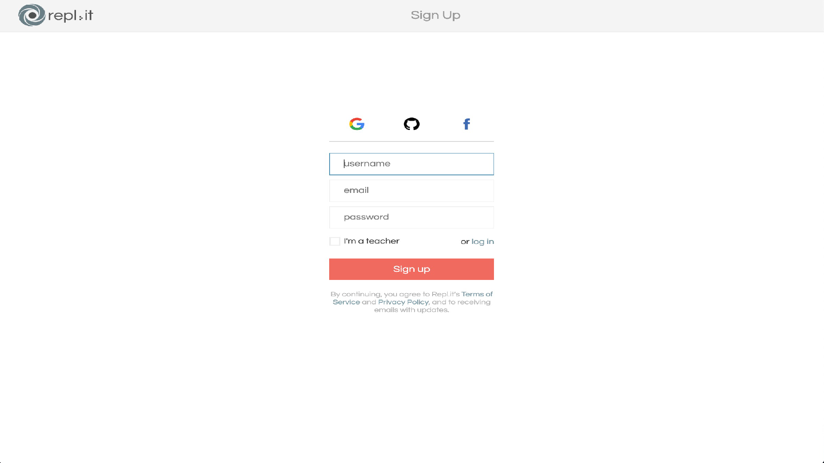

Slide 72
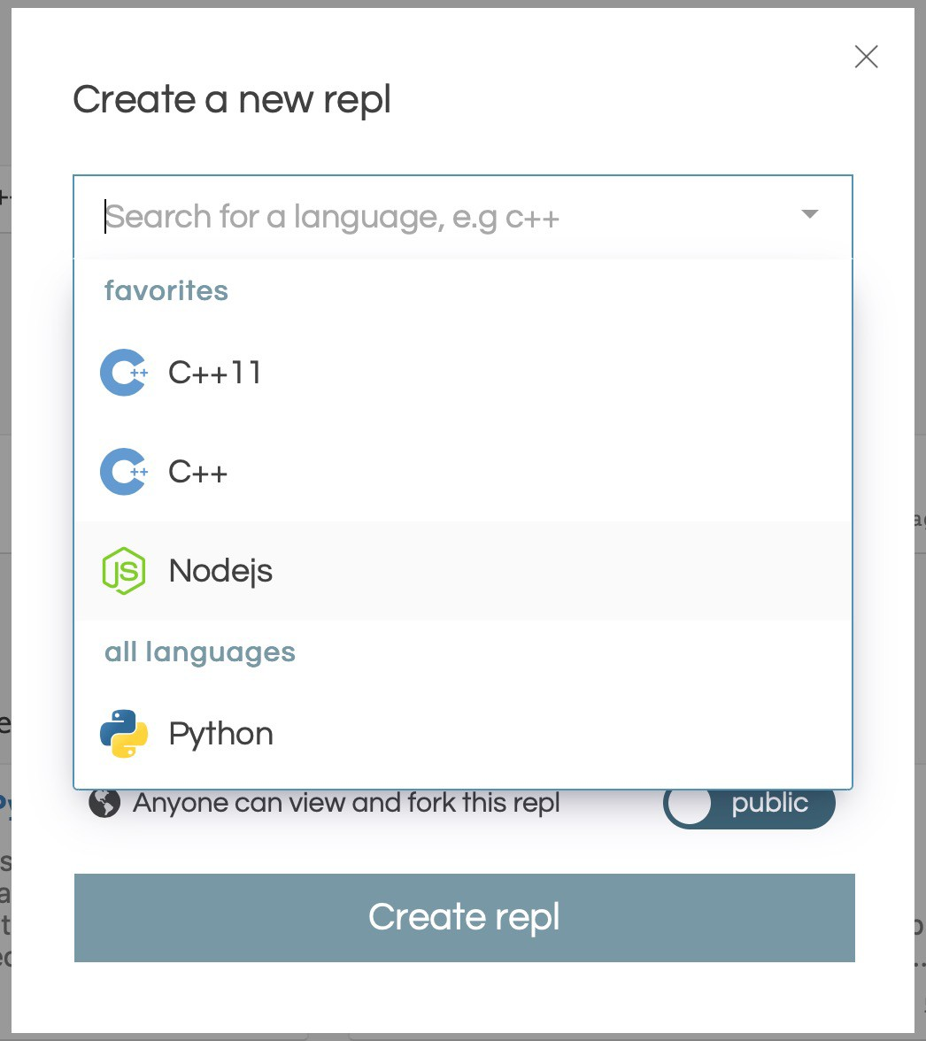

Slide 73
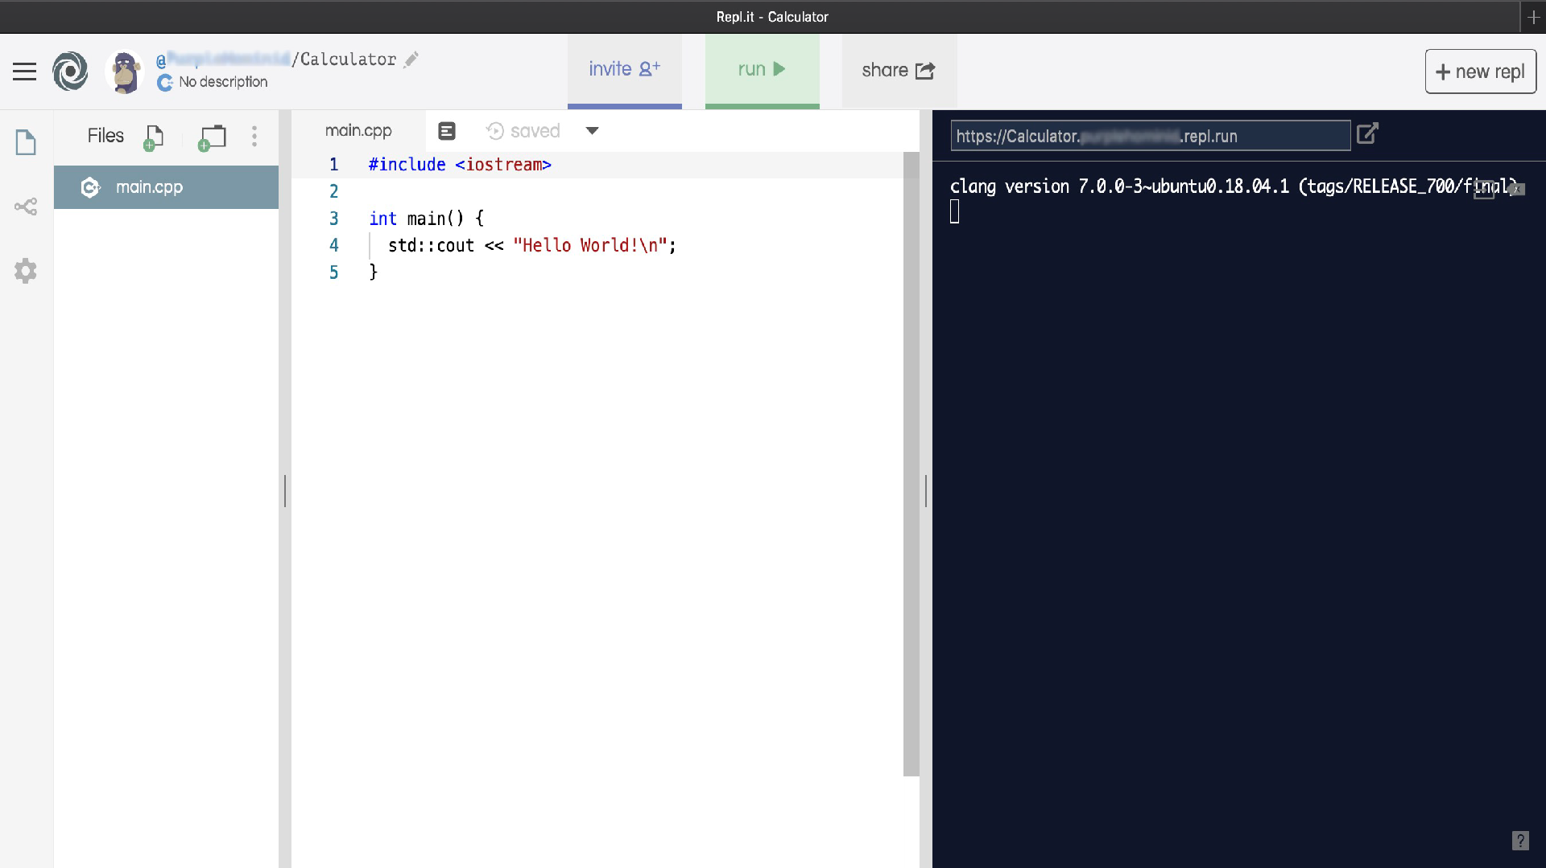
Execute Code
File Management Area
Output Area
Development Area

Slide 74
ADDWORLD()++; a first C++ program
Unfortunately, you probably wont be able to simply copy, paste and run this example code without manually having to edit it to remove the ‘formatting’ information that will likely cause your compiler to error. Retyping would be easier!
Once you’ve got it working - try expanding it to add two numbers; then divide, multiply and subtract.
#include <iostream>
int main() {
int number1;
int number2;
std::cout << "Hello World!\n";
std::cout << "Welcome to numbers" << std::endl;
std::cout << "Please enter first number\n"; std::cin >> number1;
std::cout << "You entered: " << number1 << "\n";
}

Slide 75
the end
❏ Paradigms - done
❏ Layers of Abstraction– done
❏ Data Types– done
❏ Standard Library – done
❏ C++ Example – done
❏ REPLIT - done
Just two last things…

Slide 76
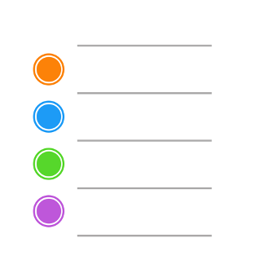
C++ Programming – Some Things to Remember
ACTIONS: MAKE A NOTE
Variables – are:
Individual boxes used to store, pass or modify data within a program
Arrays – are:
Collections of individual variables (think in a row), all of with have the same name but use different indexes
Round Brackets ( ) – are used to:
Pass arguments to functions
Define the order of operation when solving an mathematical expression
Square Brackets [ ] – are use to:
Identify the specific instance or index of an array (or array like) structure
Double Colon :: - used to:
Access a method (a.k.a. function) or property within a function
Double Quotes “..” – used to:
Declare string literal values
Single Quotes ‘.’ – used to:
Declare character values

Slide 77
2. Some Excellent, Online Resources
ACTIONS: MAKE A NOTE
Some excellent, online resources and demonstrations for C++ and other associated technologies:
https://www.w3schools.com/cpp/
https://beginnersbook.com/2017/08/c-plus-plus-tutorial-for-beginners/
http://www.cplusplus.com/files/tutorial.pdf
Feel free to explore any others you find helpful

